Slide 1
DEVELOPMENT AND IMPLEMENTATION OF THE LONG COVID APP
supervised by DI Dr. Sten Hanke
A Masterthesis by Jan Stenk

Slide 2
Agenda
Background
Question of Research
Methods
Results
Conclusion

Slide 3
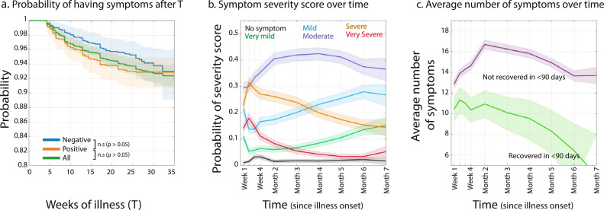
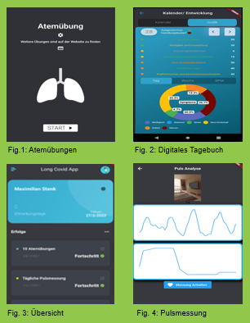
Background
Long Covid
Long lasting COVID-19 symptoms that persist after 12 weeks
Studies estimate 1/3 of all cases to be effected (DGP, 2022)
No definite therapy solutions: lack of clinical data (Wolf, 2021)
Clinical case definition through Delphi study (WHO, 2021)
mHealth-Apps
Potentials, Risks, Use Cases (Raveendran, 2021)
Quality/Usability Requirements
Long Covid Apps: Untire App, POCOS, Cogni Reha Long Covid App
Symptoms
Long Covid App Prototype
(Davis, et.al., 2021)
DGP (2022). AWMF: Post-COVID/Long-COVID Leitlinien. URL: https://www.awmf.org/leitlinien/detail/ll/020-027.html , accessed: 11.08.2022.
Austria, H., Wolf, S., und Erdös, J. (2021). Long COVID care pathways: a systematic review. URL: https://eprints.aihta.at/1342/7/HTA-Projektbericht_Nr.135b.pdf , accessed: 25.03.2022.
WHO (2021). A clinical case definition of post COVID-19 condition by a Delphi consensus. URL: https://www.who.int/publications-detailredirect/WHO-2019-nCoV-Post_COVID-19_condition-Clinical_case_definition-2021.1 , accessed: 25.03.2022.
BZgA (2022b). Long COVID: Langzeitfolgen von COVID-19. URL: https://www.infektionsschutz.de/coronavirus/basisinformationen/long-covid-langzeitfolgen-von-covid-19/ , accessed: 04.05.2022.
Raveendran, A. V., Jayadevan, R., und Sashidharan, S. (2021). Long COVID: An overview. Diabetes & Metabolic Syndrome: Clinical Research & Reviews. URL: https://www.sciencedirect.com/science/article/pii/S1871402121001193, accessed: 25.03.2022.
Davis, H. E., et.al. (2021). Characterizing long COVID in an international cohort: 7 months of symptoms and their impact. URL: https://www.thelancet.com/journals/eclinm/article/PIIS2589-5370(21)00299-6/fulltext, aufgerufen am 03.05.2022.

Slide 4
Question of Research
How can the prototype from the eHealth master project "Long Covid App" be extended to meet the demands on UI design and UI interactions of potential users?
How can tracking, analysis and visualisation of symptoms help to educate about the clinical picture, promote patient self-determination and ideally improve the clinical picture?

Slide 5
Methods
Literature Review
Software Concept
Usability Test

Slide 6
Methods
Literature Review
mHealth App Development
Long Covid-specific Requirements
Long Covid Studies
Official Long Covid Information
qualitative
Literature
Qualitative mHealth Reviews
Quantitative Long Covid Symptom studies
Long Covid case studies
Long Covid Guidelines
Long Covid Research
Official Long Covid Information
Concept
Methods
Results
Related Work
empirical

Slide 7
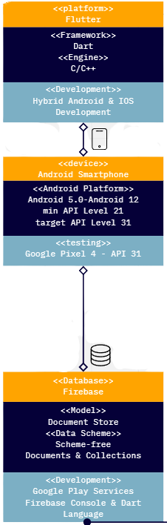




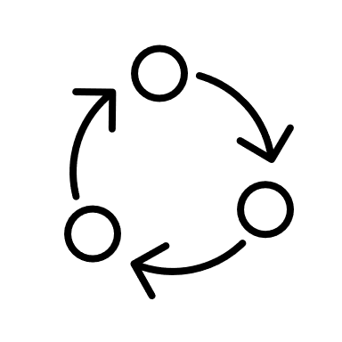


Methods
App Architecture
App Development
qualitative/
quantitative
Software Concept
Software Development
User-centered Design
Prototype based
Empirically driven
Iterative Usability-Test
Platform
Requirements
Project Management
mHealth
Data Recording
explorative/empirical

Slide 8
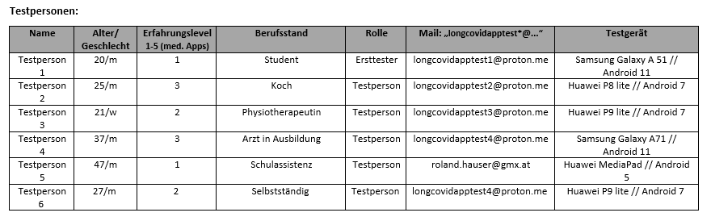
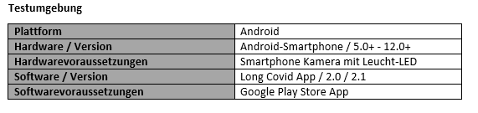
Methods
Usability Test
Parts: Usability Test 1, Usability Test 1.3, Usability Test 2
6 participants who experienced Long Covid symptoms
Dates
Long Covid App 2.1 Release
02.08.22 Usability Test 1: TA-Test, cognitive walk-through
17.08.22 Usability Test 1.3: 30 day test part 2
Long Covid App 2.2 Release
31.08.22 Usability Test 2: Evaluation UI
Usability Test
Longitudinal designed questionnaire
Thinking-Aloud-Test
30 day follow up
Cognitive walk-through
Surveys
Functionality and Design Testing
Contents
qualitative/
quantitative
explorative

Slide 9
Results
App Components
Long Covid App 2.1
Usability Test
Long Covid App 2.2

Slide 10
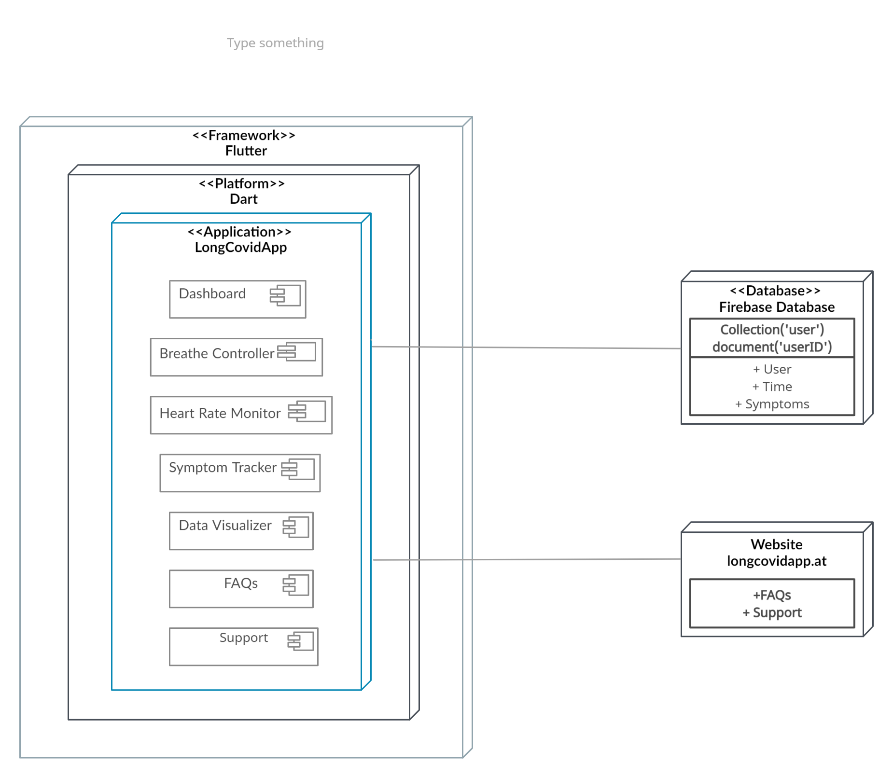









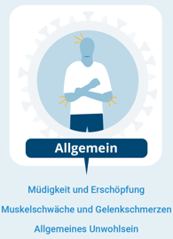
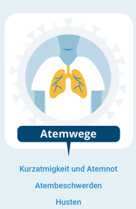
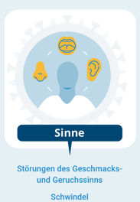



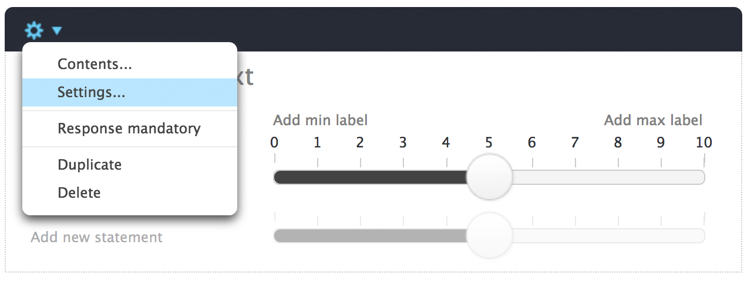
Results: App Components
Heartrate measurement through camera and light sensor
Symptom tracking
Breathing exercise with adjustable breathing time
Symptom data visualization
Long Covid Information
Symptom Severity Scale
(BZgA, 2021)
BZgA (2022b). Long COVID: Langzeitfolgen von COVID-19. URL: https://www.infektionsschutz.de/coronavirus/basisinformationen/long-covid-langzeitfolgen-von-covid-19/ , accessed: 04.05.2022.
10

Slide 11
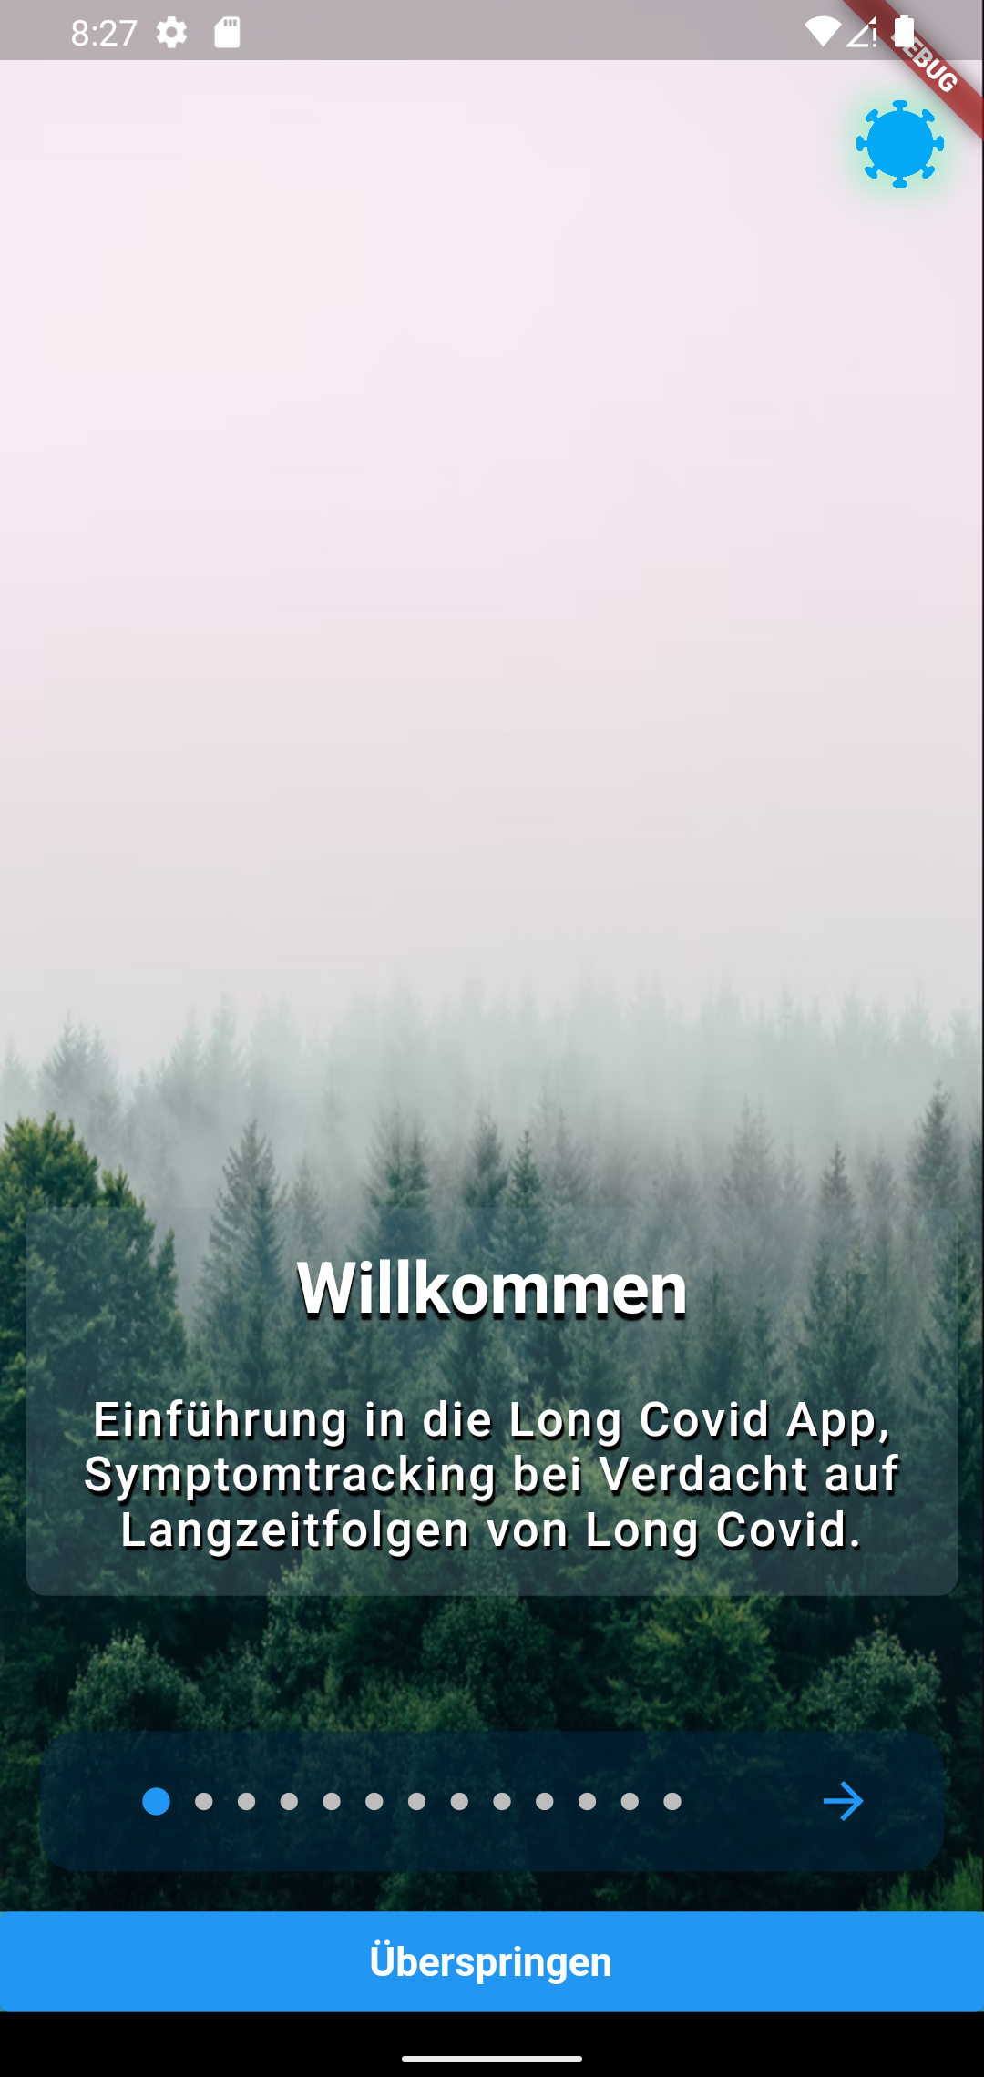
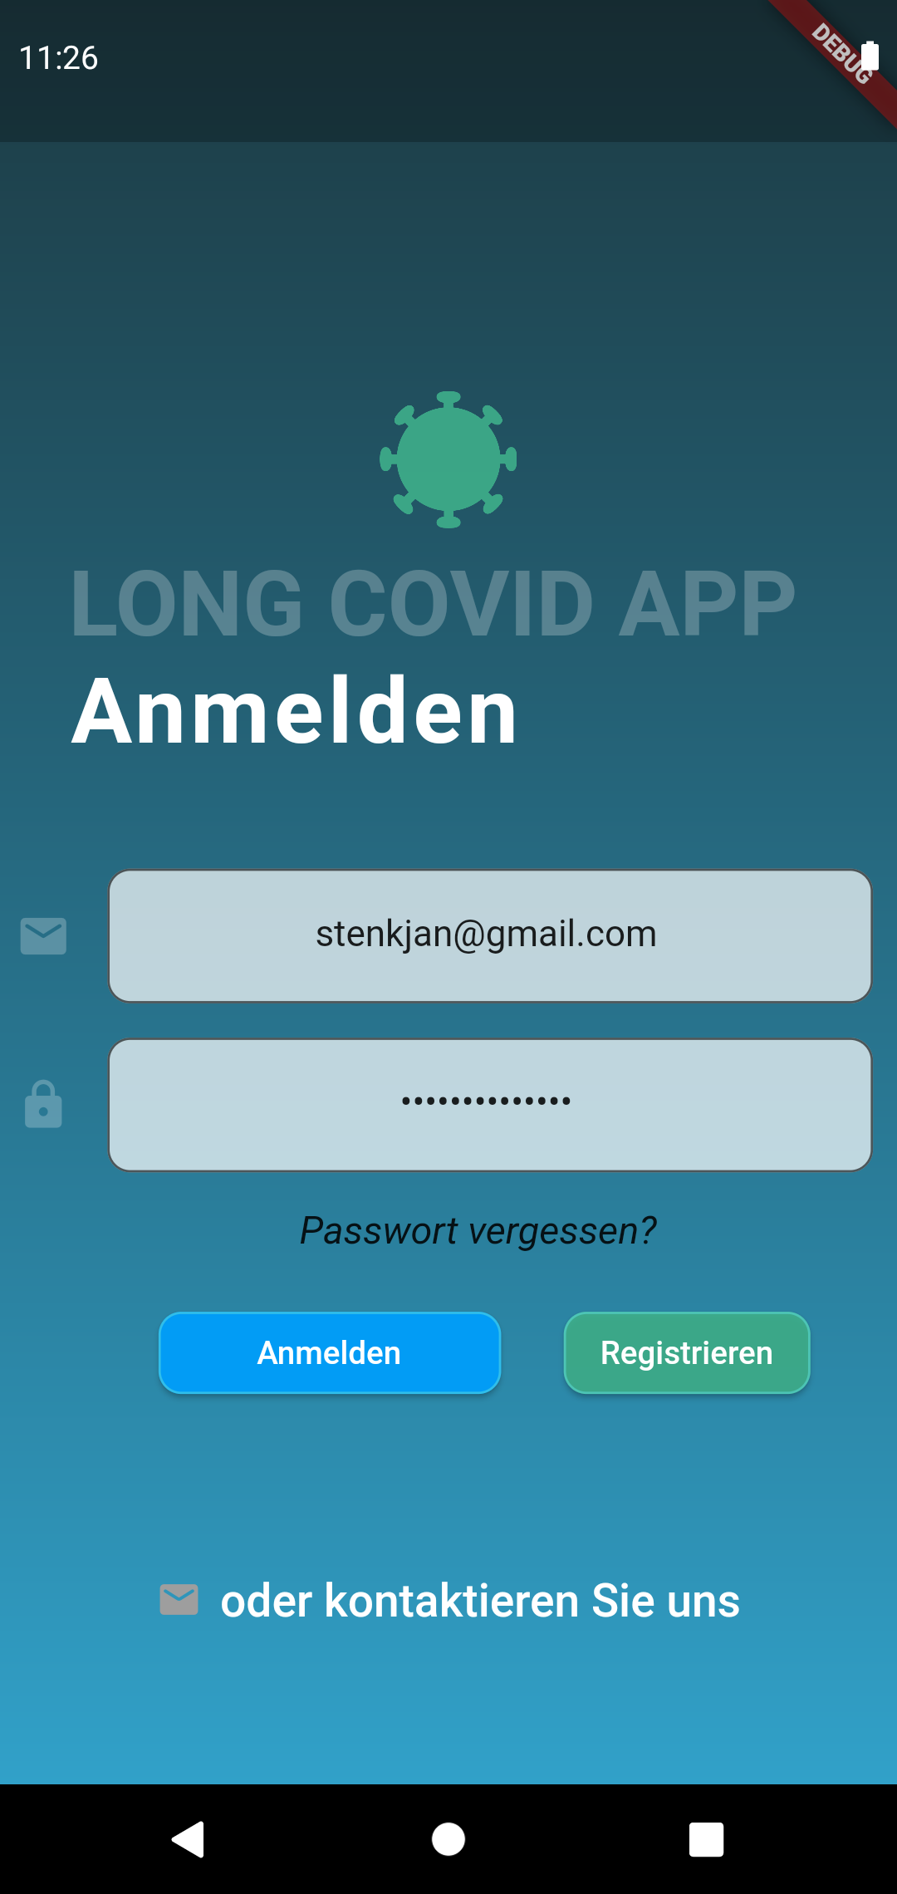
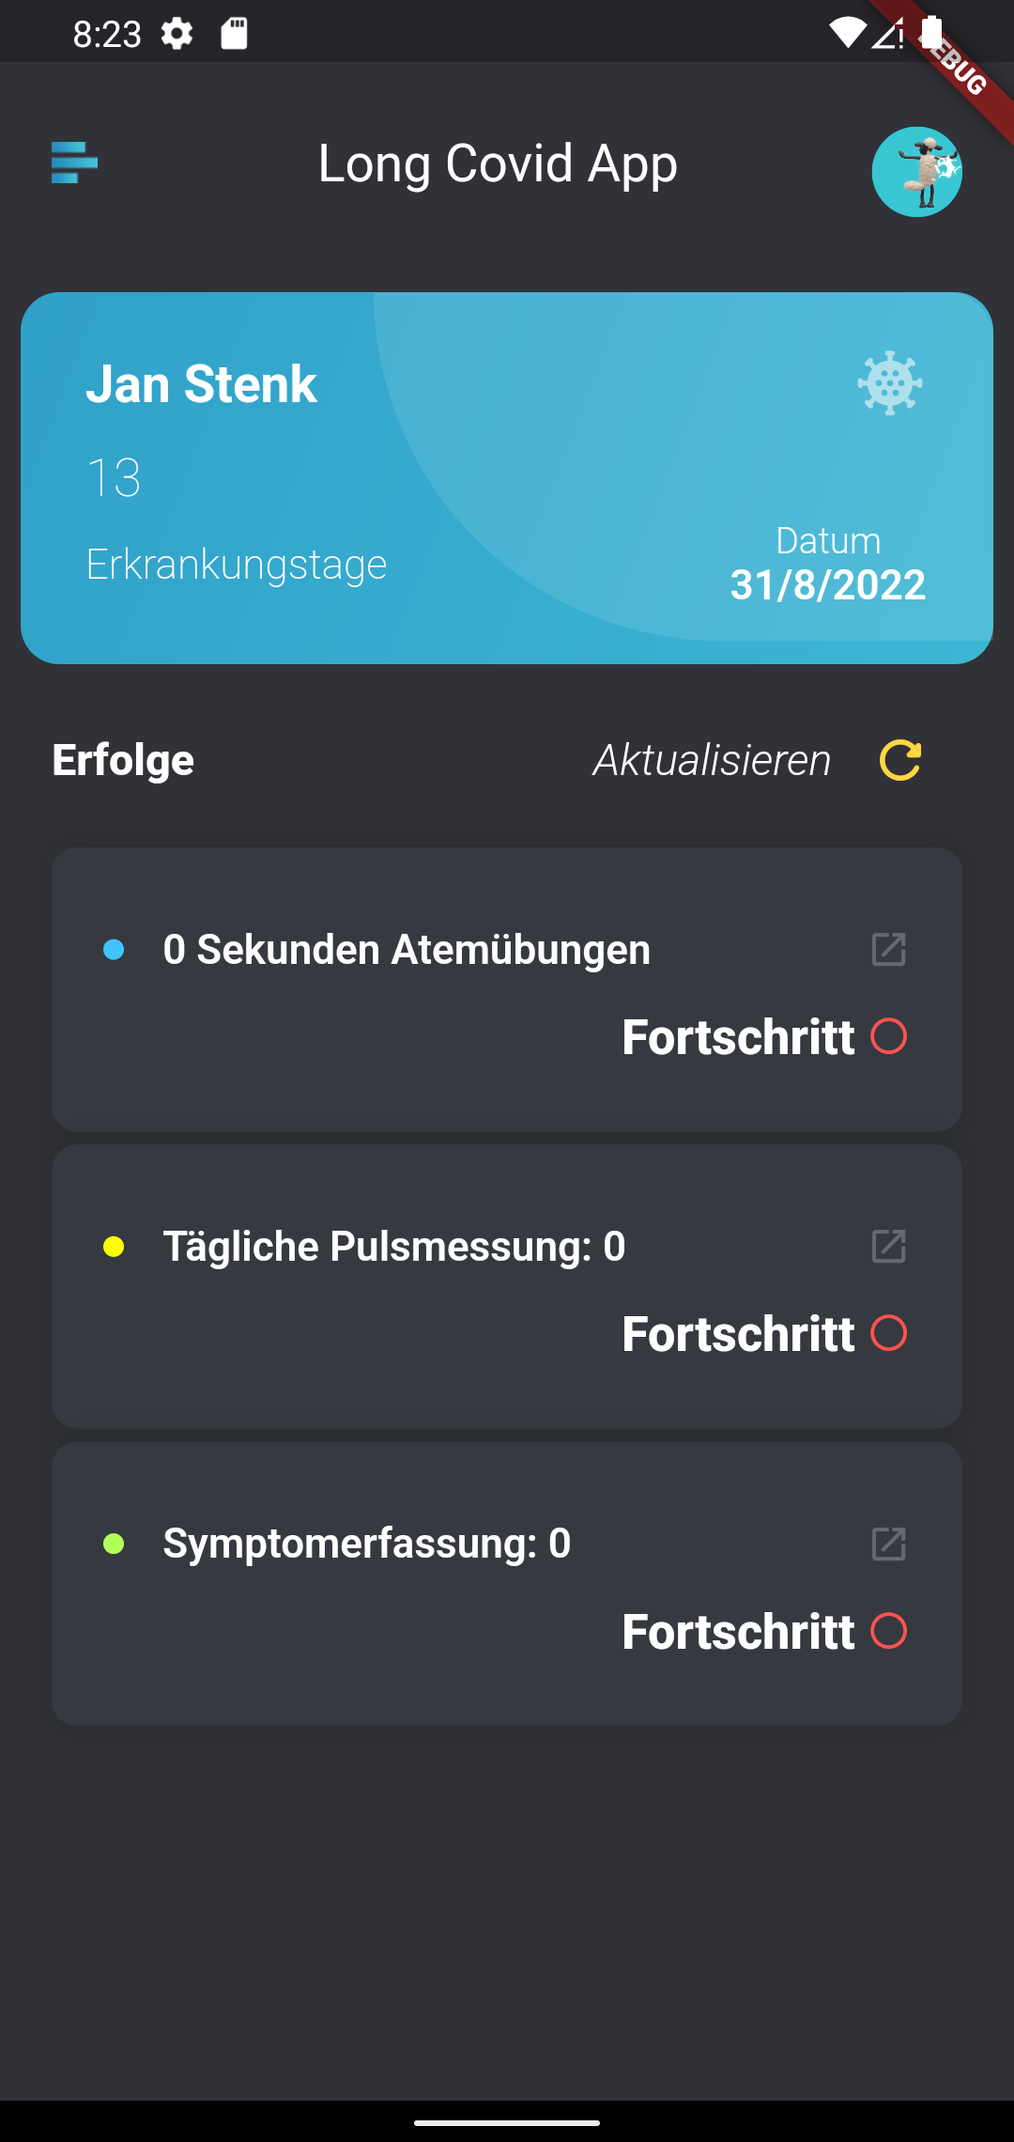
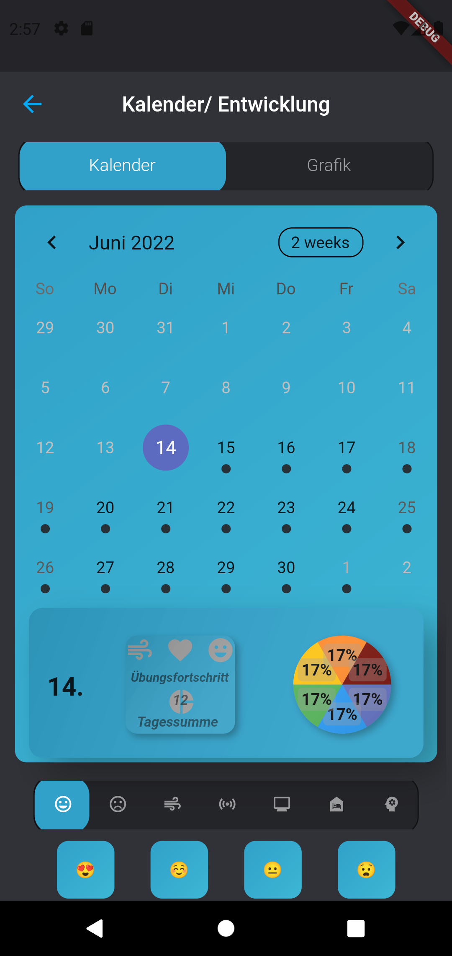
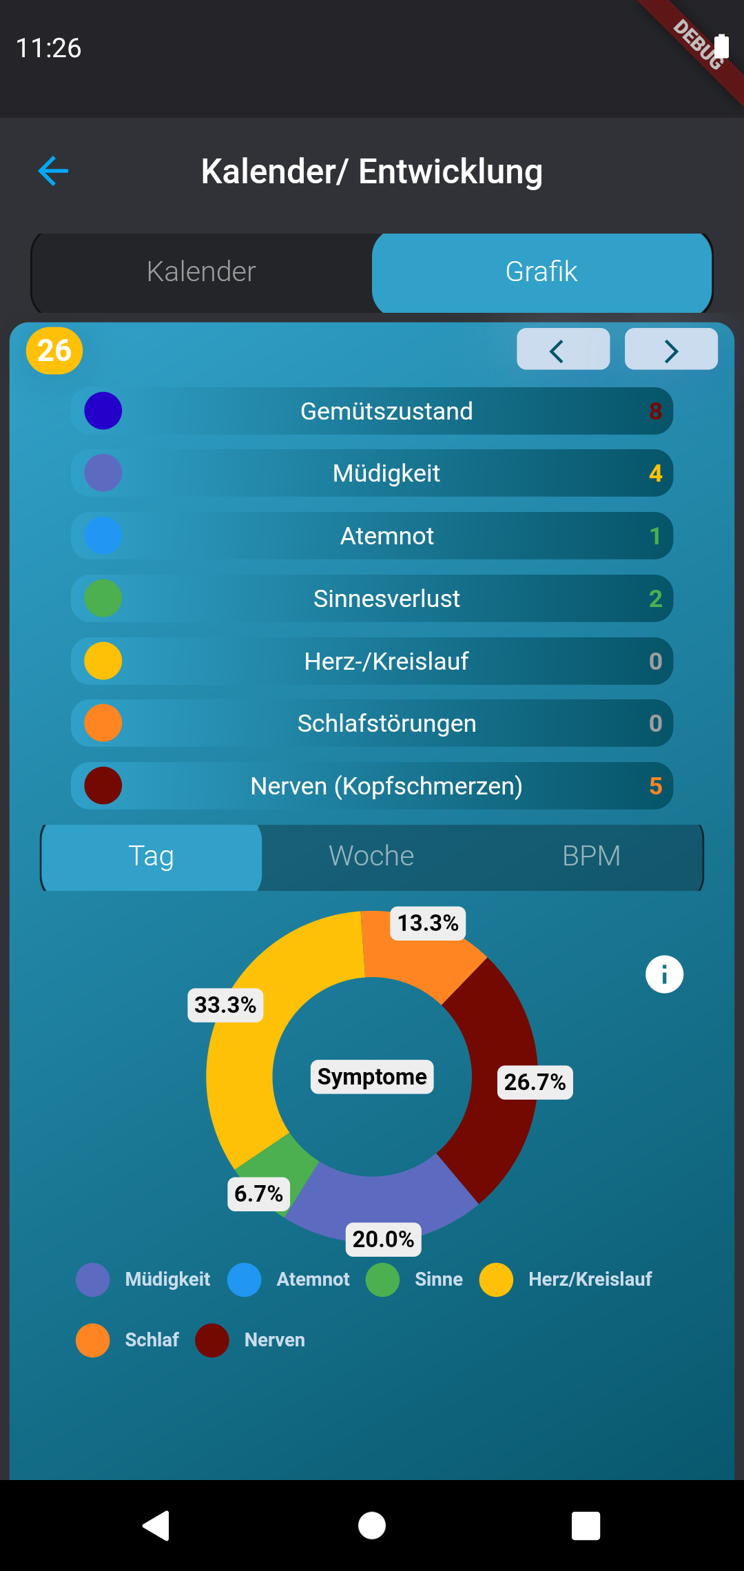
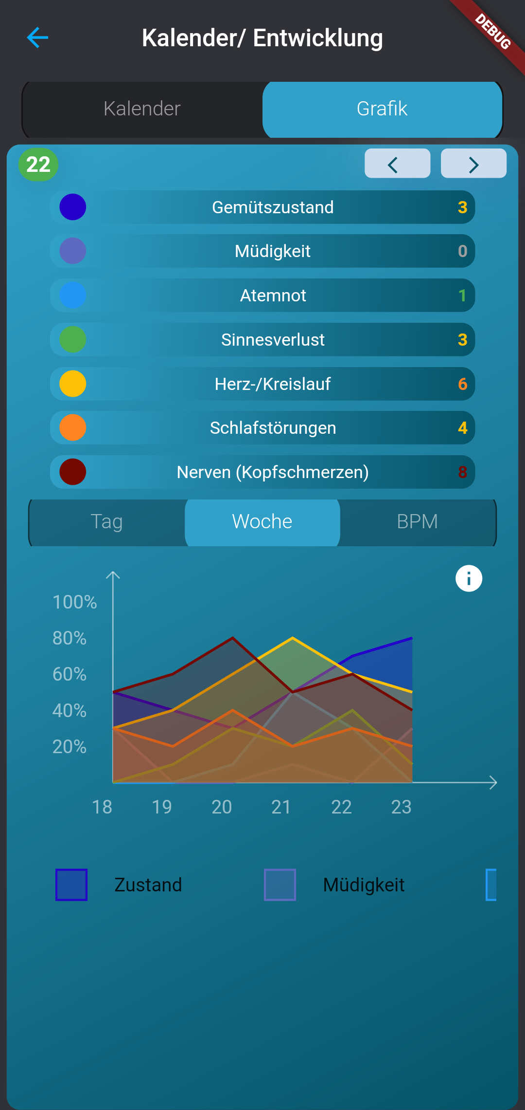
Results - LC App 2.1
Concept
Software Design
UI
Usability
Software Functionality
Symptom Tracking
Exercises
Usability Test 2
Design & Interaction
Health Benefits
Long Covid App 2.1
BZgA (2022b). Long COVID: Langzeitfolgen von COVID-19. URL: https://www.infektionsschutz.de/coronavirus/basisinformationen/long-covid-langzeitfolgen-von-covid-19/ , accessed: 04.05.2022.

Slide 12
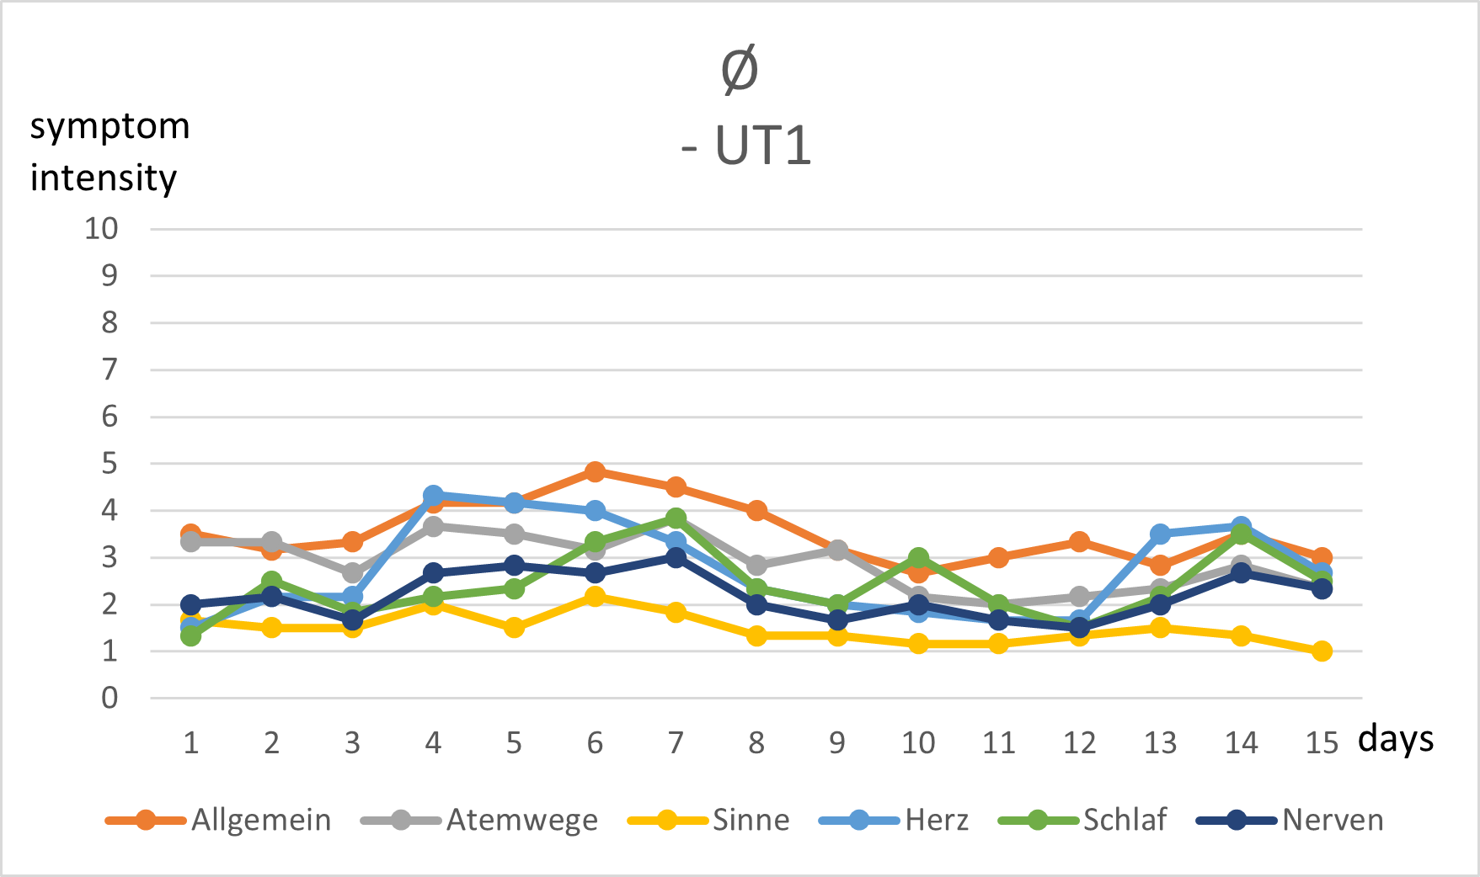
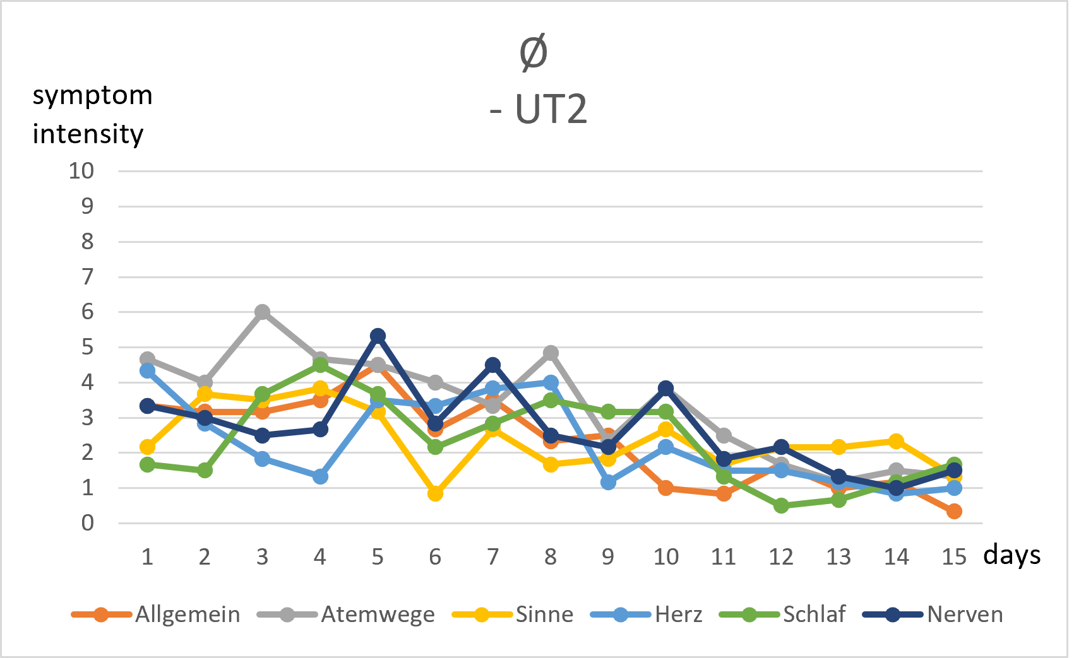
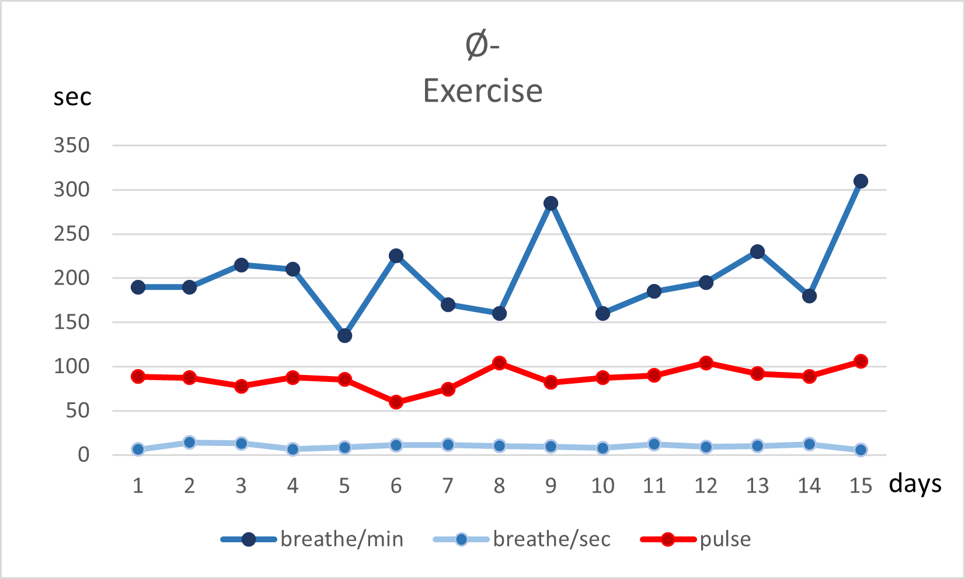
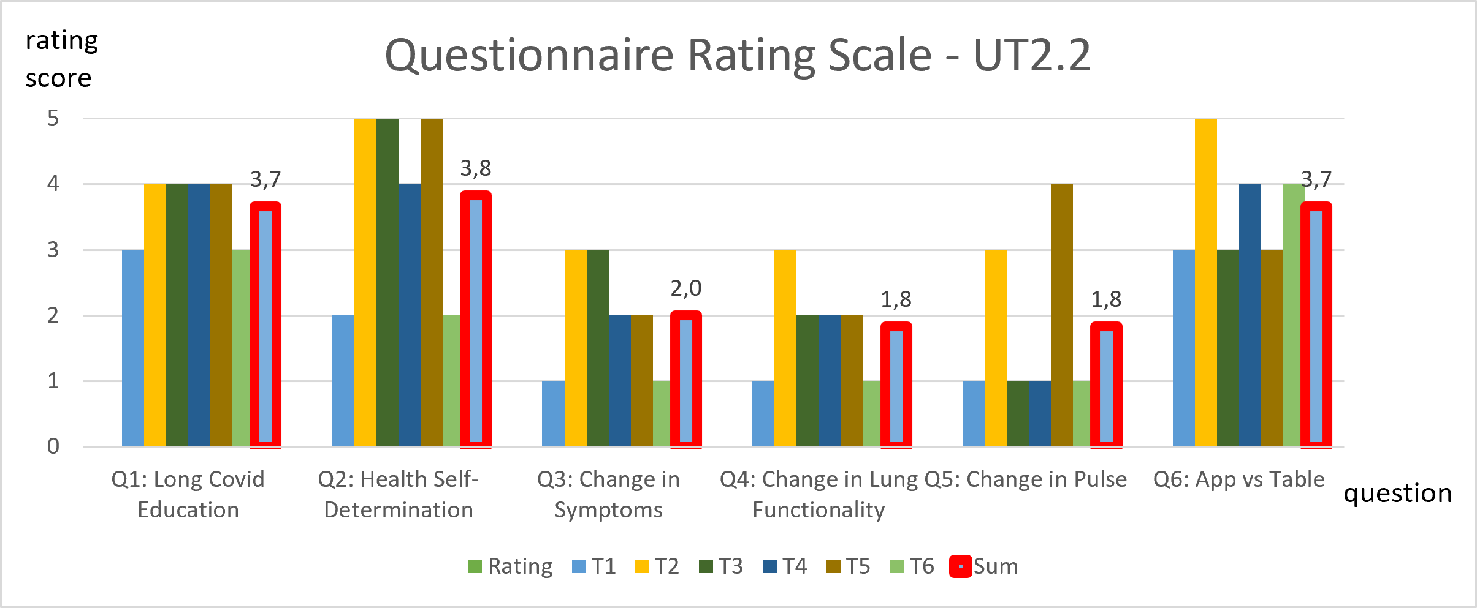
Results - Usability Tests
UT 1.3 30 Day Test
UT1: Paper-based Symptom Test
UT 1.3: App-based Symptom Test
Higher mean avg. and outliers
UT1.3: Exercise Evaluation
No real irregularities
UT 2.2: Rating Survey
Focused on evaluation of QoR Part 2

Slide 13
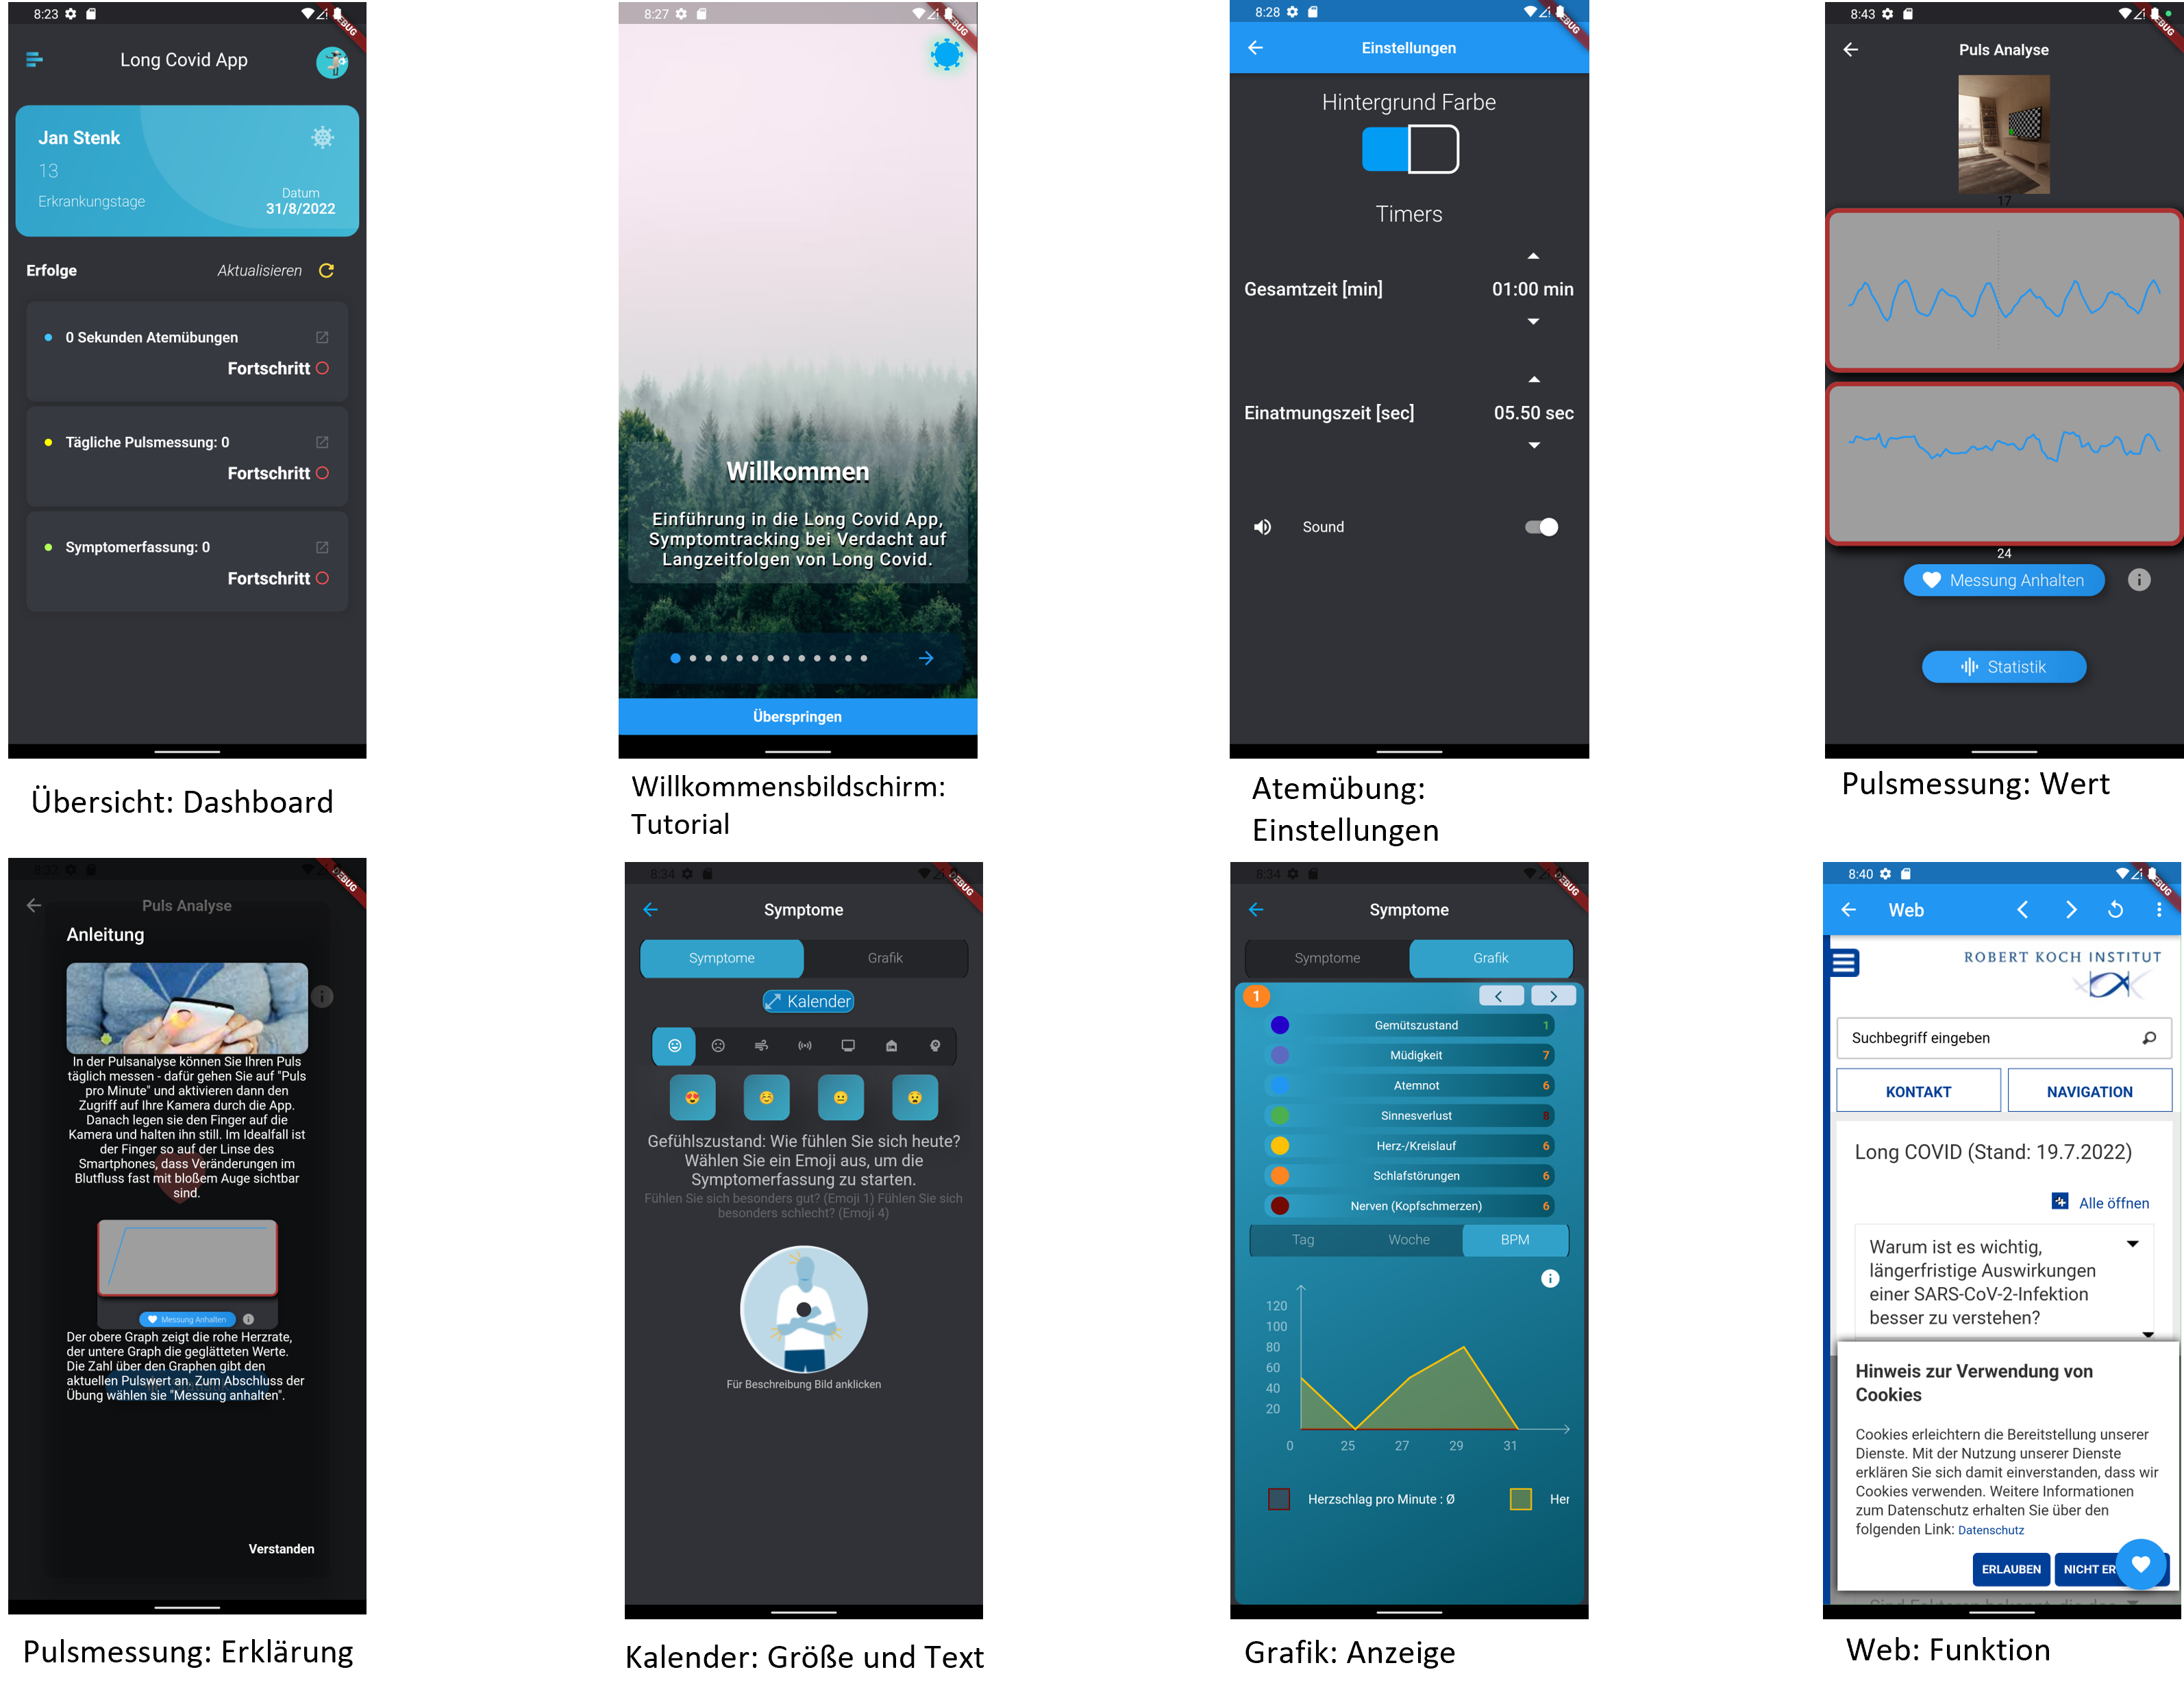
Results – LC App 2.2
Implementing Feedback of Usability Test 2: Design & Functionality Update
Input from Usability Test
Thinking Aloud Test
Cognitive walk-through
Surveys
Long Covid App 2.2 Update
Dashboard
Introduction
Exercises
Symptom Tracking
Symptom Visualisation
Webview for Long Covid

Slide 14
Discussion & Conclusion
QoR1: UI Design and UI Interaction requirements of potential users
Concept Evaluation
mHealth related literature evaluation and incorporation of best practices
Usability Test Evaluation
Usability Test comparison indicates improvements in the rating of UI Design & Interaction
QoR2: Tracking, Analysation and Visualisation to educate, improve self-determination and health
Symptom Tracking Analysation
Consistent tracking amongst all participants
Bigger variety in App vs table based symptom tracking
Usability Test 2.2 Survey
Improvement in education (3,7) about condition
Improvement in health literacy and self-determination (3,8)
App favoured above paper based symptom tracking (3,7)
No improvement of symptoms detectable (1,8)

Slide 15
Discussion & Conclusion
Limitations in Research
Lack of clinical data (WHO, 2021)
Symptom variety and severity unspecified
Guideline Classification S1 for Long Covid(DGP, 2022)
Future Prospects
mHealth’s role in health education (Vaghefi, 2019; Jahns, 2014)
mHealth benefits in primary health care (Stonbraker, 2018)
Impact of Long Covid
No support for non-hospitalized patients (Subramanian, 2022)
Related Apps: Untire, POCOS, Cogni Reha Long Covid App
Limitation in Findings
Population size
Usability Test design
Symptom Tracking & Monitoring functionality limitations
Long Covid App Potential
mHealth functionality expansion
Improve symptom acquisition
Implement other health beneficial components
State of the Art Updates
Incorporate new findings on Long Covid
Improve overall functionality
Revised study design
WHO (2021). A clinical case definition of post COVID-19 condition by a Delphi consensus. URL: https://www.who.int/publications-detailredirect/WHO-2019-nCoV-Post_COVID-19_condition-Clinical_case_definition-2021.1 , accessed: 25.03.2022.
DGP (2022). AWMF: Post-COVID/Long-COVID Leitlinien. URL: https://www.awmf.org/leitlinien/detail/ll/020-027.html , accessed: 11.08.2022. DGPB e.V.
Subramanian, A., et.al. (2022). Symptoms and risk factors for long COVID in non-hospitalized adults. URL: https://www.nature.com/articles/s41591-022-01909-w, accessed: 11.08.2022.
Vaghefi, I. und Tulu, B. (2019). The Continued Use of Mobile Health Apps: Insights From a Longitudinal Study. URL: https://www.ncbi.nlm.nih.gov/pmc/articles/PMC6740166/ , accessed: 03.09.2022.
Stonbraker, S., et.al. (2018). Usability Testing of a mHealth App to Support Self-Management of HIV-Associated Non-AIDS Related Symptoms. Studies in health technology and informatics. URL: https://www.ncbi.nlm.nih.gov/pmc/articles/PMC6310175/ , accessed: 03.09.2022.

Slide 16
DEVELOPMENT AND IMPLEMENTATION OF THE LONG COVID APP DISCUSSION
supervised by DI Dr. Sten Hanke
A Masterthesis by Jan Stenk

